Slide 1
Ido Aviv Memorial- Free surfboard for each soldier Ofek Yabo, Dolev David, Segev Olpak, Guy Yehoshua
Software Engineering
Faculty of Engineering
Ben Gurion University of the Negev

Slide 2
Project Title
Free surfboard for each soldier
גלשן בחינם עבור כל חייל
Student Name | ID | Email | Phone | Signature
Ofek Yabo | 209288588 | Yaboofe@post.bgu.ac.il | 0547729233 | Ofek
Dolev David | 207244021 | DolevDav@bgu.ac.il | 0509140464 | Dolev
Segev Olpak | 325176188 | Olpak@post.bgu.ac.il | 0526550098 | Segev
Guy Yehoshua | 326529229 | Guyyeho@post.bgu.ac.il | 0533345483 | Guy

Slide 3
Customer
Gil Hurvitz
Customer Representative Person
The surf club manager and Ido's employer
Gil.hurvitz1@gmail.com
0505505010
מרכז ימי קרית ים
More Advisors: Wix support and sponsor this important memorial project.

Slide 4
Introduction
A project in memory of Ido Aviv, who was head of surf coaching in Gil’s surf club at Kiryat Yam and fell in the war.
We will develop an end-to-end system that allows soldiers to scan their IDF card and open a lock that allows them to borrow a free surfboard at lifeguard towers in Israeli beaches.
The project combines sensors, hardware, and a flexible backend system that will support expansion and conversion of the platform to additional channels. On top of that the system will integrate into a Wix memorial website dedicated to Ido Aviv.
Problems we solve: A flexible system that manages entities, manages users and permissions, monitors the status of equipment in real time, allows for expansion and addition of objects, maintains the security of users' information, interfaces to work with sensors and physical hardware components, and finally interfaces to work through the WIX website in a convenient way. In addition, a unique scan of the soldier's card will be used to verify his identity - something that is already registered in a patent that is unique to this project.

Slide 5
Project’s Motivation and Purpose
The project took shape after Ido's death in the war by Gil Horowitz and Ido's family, who were looking for ways to commemorate him in a way that best suited Ido. Ido used to say: "Take a surfboard, I trust you." The project began to take shape over time, one after another, and today there is a memorial site for Ido, and a surfboard cabinet located in the surf club that was designed to be opened remotely by scanning a soldier's card. The problem is that the project was built in a very specific way and is not suitable for expansion. Our ambition is that the entire project will be in memory of Ido, and in cooperation with municipalities we will be able to place additional cabinets throughout the country, thus commemorating the city's loved ones who were connected to the sea throughout the country using the platform we will create for Ido. In fact, we are creating a large platform to commemorate the soldiers who were connected to the sea, in a way that gives back to the soldiers who are fighting for us now.

Slide 6
Project Description
A system for managing entities, users and permissions, to which objects can be added over time. The system should be built flexibly so that the platform can be copied for additional formats in the future (not necessarily surfboards).
In addition to the system, we will implement the functionality to identify and authenticate users based on IDF id. We will also develop the physical system that will withstand challenging environmental conditions and interface between the hardware and the system. Finally, we will implement everything under interfacing with the WIX website intended to commemorate Ido.
Functionality: object management, user management, permission management, hardware control and fault reporting, monitoring the status of the surfboards, remote lock opening, smart user authentication mechanism, adding new physical cabinets, adding surfboards to existing cabinets, integrating the system seamlessly with the existing WIX website.

Slide 7
Customer – what exists? What provides?
Memorial base website for Ido.
Patent to scan and identify IDF id cards.
Basic locker prototype.
Support/sponsorship from WIX.
Electrical hardware expertise from Gil (the client).
Also provided is the entire hardware necessary.

Slide 8
Project’s Risk Assesment (and how to overcome)
Challenge | How to overcome?
Integrating our system with microprocessor, sensors & other hardware | Our client is an Electrical Engineer and will help us handle it
Rigorous Data security since we handle sensitive private info like personal & military ID. | VPC, encryption, WAF etc…
Integrating our system into the existing Ido Aviv memorial website. | Collaborate with the family & the developer of the website.

Slide 9
User Interface
The system will run under existing WIX website. We will add our system functionality seamlessly under new tab.
The website should allow different functionality to admins and regular users.
Ido Aviv | Surfo

Slide 10
Project’s Environments and Langugaes
For the Backend, we’ll use python3 as the main programming language, alongside with frameworks like:
FastAPI for web API, SQLAlchemy for ORM, Pytest for testing & QA.
We plan to host in AWS in a mostly serverless environment, with services like Lambda, Aurora serveless v2, API gateway, S3 and more... For the Frontend, we will be assisted/sponsored by WIX for the project, so the UI will be written in JavaScript.
Should you learn? How will you learn?
We should. We will use language & service documentations, LLM’s & Educative websites like W3code to learn.
And in regard to hardware related stuff, our client is an Electrical Engineer and will assist us.

Slide 11
Evaluation and Testing Plan
We will perform tests at all levels of the software, (unit, integration, acceptance)
In addition to the software level tests, we have a prototype that will be connected to the system and on which we will perform comprehensive manual acceptance tests. In addition, there is an active cabinet at the surfing club that Gil maintains in the field under real conditions.

Slide 12
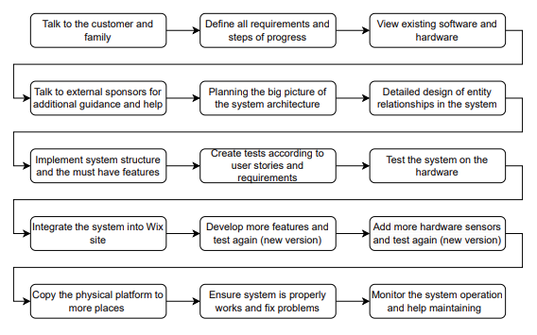
Project’s Steps and Timeline
TimeLine
Diagram

